Slide 1
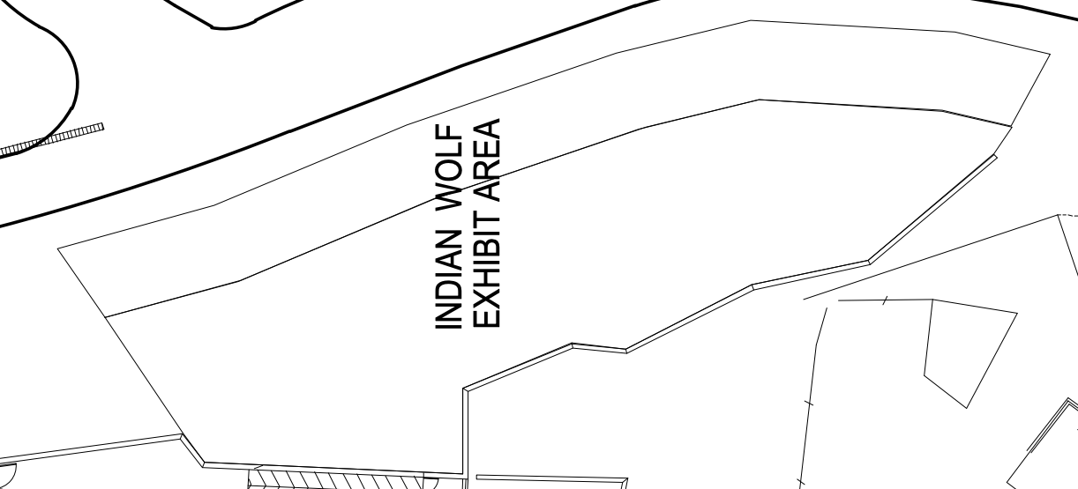
Tram Route
Dry Moat
Legend
= Water Cascade
= Horizontal Logs
= Boulders

Slide 2
Legend
= Water Trough
= Pool
= Water Cascade
= Horizontal Logs
= Standing Logs
= Boulders
= Platform
= Zipline
Glass
Exhibit

Slide 3
